Slide 1
MVC Architecture in Javaweb
<number>/41

Slide 2
Objectives
+ Understand MVC Architecture pattern
+ Apply MVC Architecture pattern in Java Web Application
<number>/41

Slide 3
What is MVC
Model–view–controller (usually known as MVC) is a software design pattern commonly used for developing user interfaces that divide the related program logic into three interconnected elements.
MVC proposes the construction of three distinct components. One side for the representation of information, and on the other hand for user interaction
  Model : The central component of the pattern. It is the application's dynamic data structure, independent of the user interface. It directly manages the data, logic, and rules of the application.
  View : Any representation of information such as a chart, diagram, or table. Multiple views of the same information are possible, such as a bar chart for management and a tabular view for accountants.
  Controller: Accepts input and converts it to commands for the model or view.
<number>/41

Slide 4
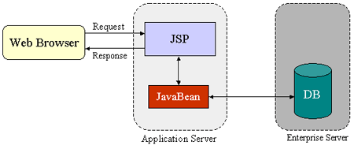
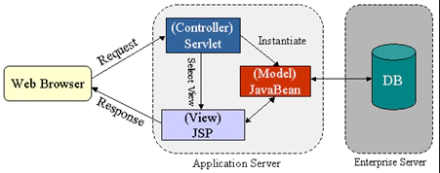
MVC Architecture
The JSP specification presents two approaches for building web applications using JSP pages
The JSP page is responsible for processing requests and sending back replies to clients
Integrates the use of both servlets and JSP pages
JSP pages are used for the presentation layer, and servlets for processing tasks
This model promotes the use of the Model View Controller (MVC) architectural style design pattern
<number>/41

Slide 5
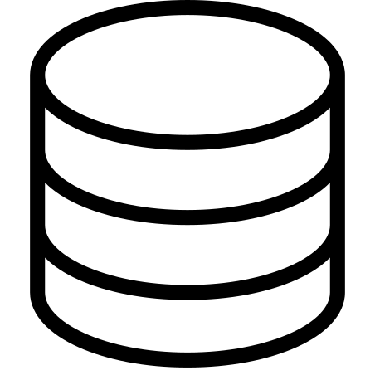
The Model
It is the specific representation of the information with which the system operates. Logic ensures the integrity of data and allows to derive it
<number>/41

Slide 6

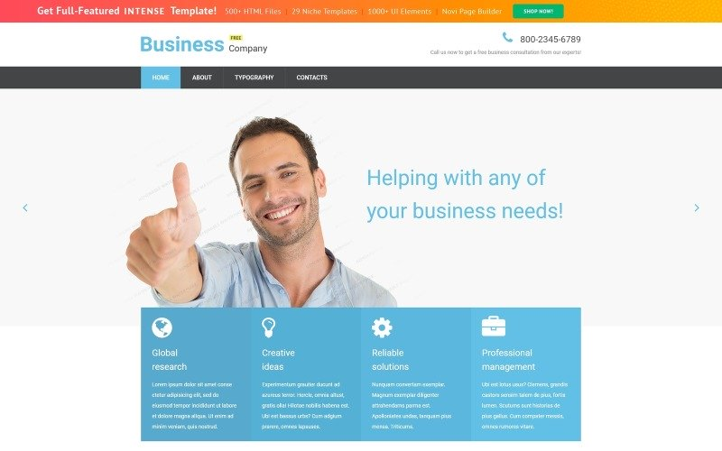
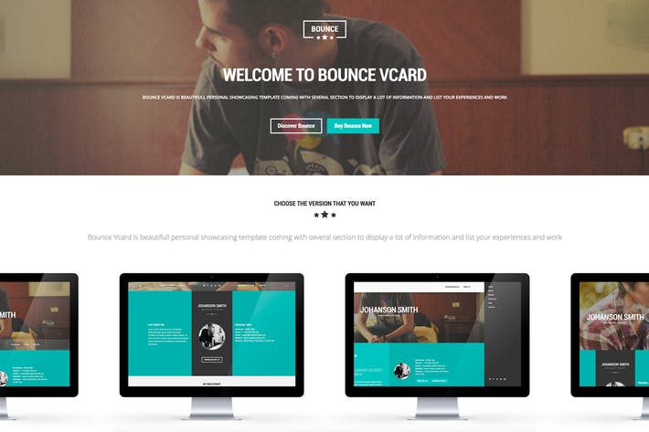
The View
Represents the model in a suitable format to interact and access the data, usually call “User Interface” (GUI Java, HTML, XML)
<number>/41

Slide 7

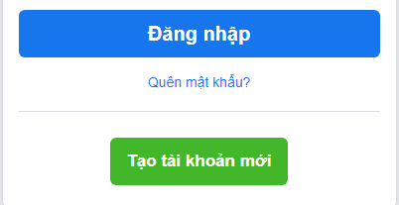
The Controller
It is the link between the view and the model, is responsible for receiving and responding to events, typically user actions invokes changes on the model and probably in the view
<number>/41

Slide 8
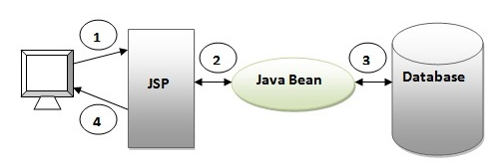
MVC1 and MVC2
MVC1:
  Servlet and JSP are the main technology to develop the web application
  Pros: Easy and Quick to develop web application
  Cons:
    Navigation control is decentralized
    Time consuming for custom JSP tag
    Hard to extend
<number>/41

Slide 9
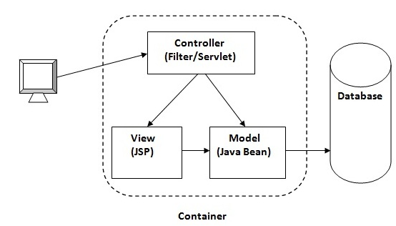
MVC1 and MVC2
MVC2:
  Base on MVC design pattern which consist of three modules model, view, and controller
  Pros
    Navigation control is centralized
    Easy to maintain
    Easy to extend
    Easy to test
    Better separation of concerns
  Cons
    We need to write the controller code self. If we change the controller code, we need to recompile the class and redeploy the application.
<number>/41

Slide 10
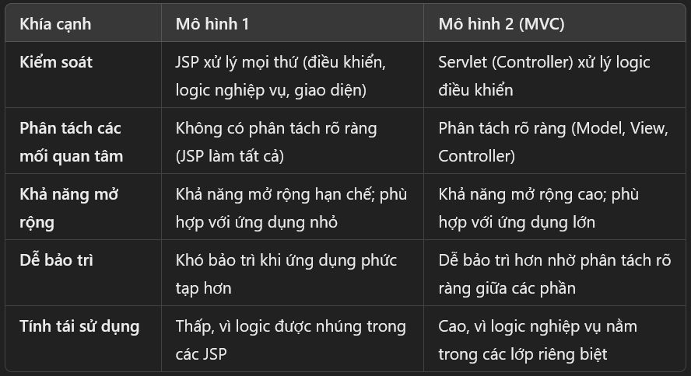
Model 1 and MVC
Filter
<number>/41

Slide 11
Benefits
Organization
Rapid Application Development
Reusing Code
Parallel development
It represent the same information in different ways
The views and application behavior should reflect the manipulations of the data immediately
It allow different user interface standards or port it to other environments where the application code should not be affected
<number>/41

Slide 12
The MVC pattern
Control flow
  The user performs an action on the interface
  The controller takes the input event
  The controller notifies the user action to the model, which may not involve a change of state of the model
  It generates a new view. The view takes the data model
  The user interface waits for another user interaction, which starts a new cycle
<number>/41

Slide 13
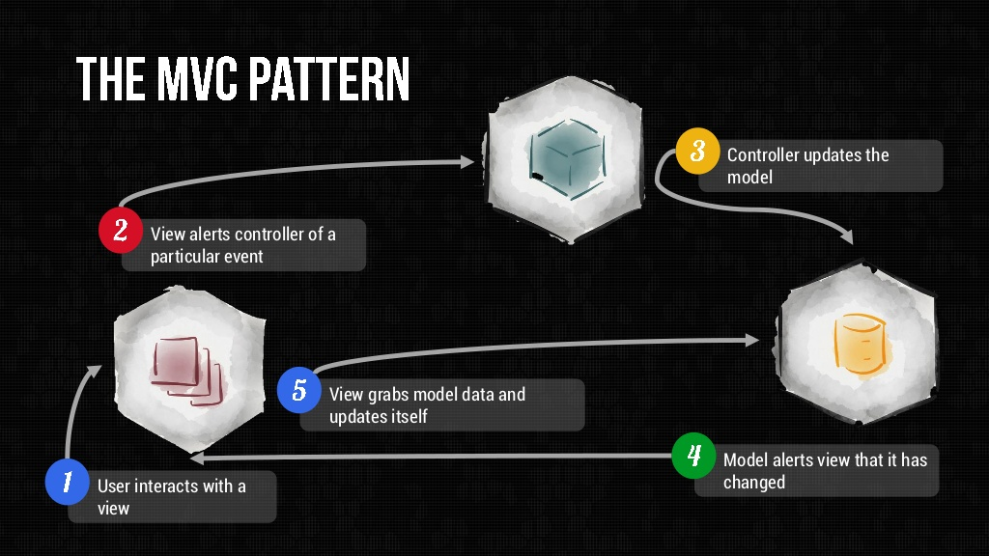
The MVC pattern
<number>/41

Slide 14
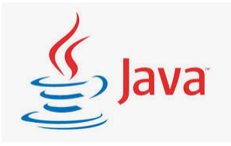
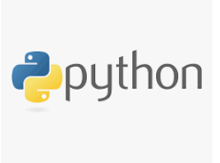
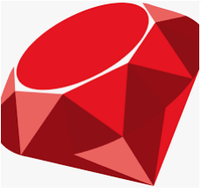
Where it can use?
It applies to all ty of systems
And technologies (Java, Python, Ruby, Perl,
SmallTalk, …)
<number>/41

Slide 15
MVC in Java
Model: made by the developer
View: set of object of classes that inherit from java.awt.Component
Controller: the event processing thread, which captures and propagates the event to the view and the model. Treatment classes of events sometime as anonymous classes) that implement EventListener type interfaces (ActionListener, MouseListener, WIndowListener,…)
<number>/41

Slide 16
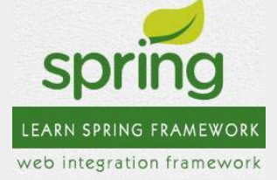
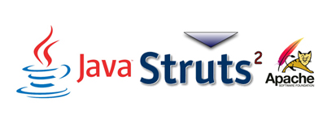
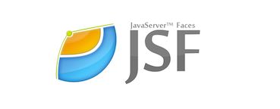
MVC Framework
Spring: one of the oldest Java Web Frameworks, but as one says: Old but Gold. Up to now, it is still utilized and constantly changing, developing more changes with Java.
Struts: a free and open source framework for creating simple Java apps. It is mainly used to create the foundation for web apps, and works on the pattern "MVC" - Model-View-Controller.
JavaServer Faces: supported by Oracle, so it produces a super long and complicated document.
<number>/41

Slide 17
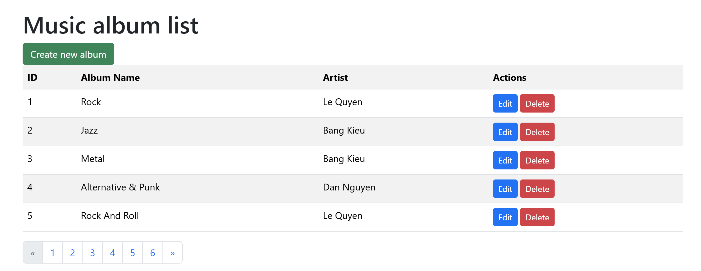
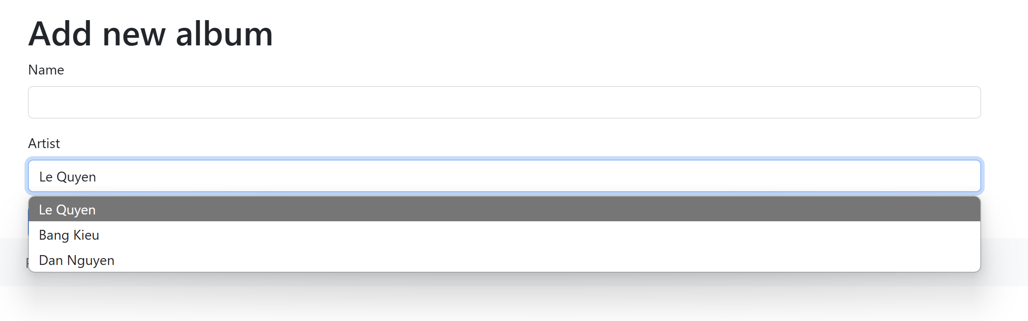
Exercise
Implement album functionality: CRUD
Filter
<number>/41

Slide 18
Summary
MVC Introduction
What is MVC?
MVC Architecture
The Model
The View
The Controller
MVC1 and MVC2
Benefits
MVC pattern
Where is can use?
MVC in Java
Framework
<number>/41

